Slide 1
Acoustic Signal analysis

Slide 3
Grinding and Polishing process
Lenses are made from materials such as glass or plastic, and are grinded and polished to a desired shape.
Grinding is the process of grinding flat sheet glass to the correct form of the lens
Polishing is the process of creating a smooth and shiny surface by rubbing it or by applying a chemical treatment.

Slide 4
Acoustic emission in Polishing process
Acoustic emission monitoring is useful to study the fracture modes and kinetics in various materials, especially in fiber reinforced composites. In glass fiber reinforced composites (GFRPs), many types of fractures can be distinguished by careful AE source waveform analysis.

Slide 5
Acoustic emission analysis methodologies
Fourier Transform
Fast Fourier Transform
Wavelet Transform

Slide 6
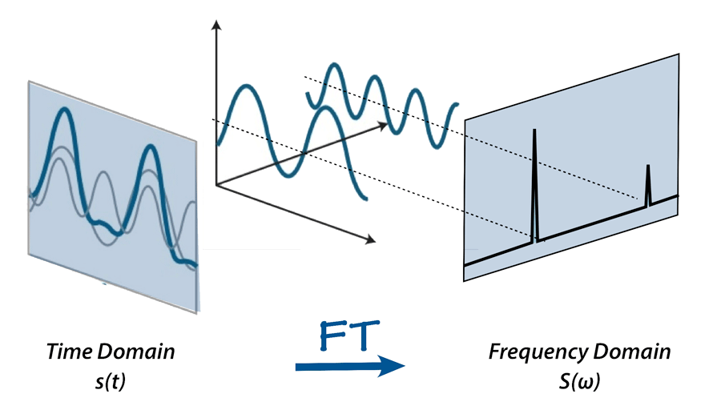
Fourier Transform

